Slide 1
Project overview & Data
GOAL
After installing an additional chair lift to help increase the distribution of visitors across the mountain more people should come to visit the place.

Slide 2
Data Wrangling
We found the dataset Single CSV file of US resort data From DataBase Manager updated_ski_data.csv

Slide 3
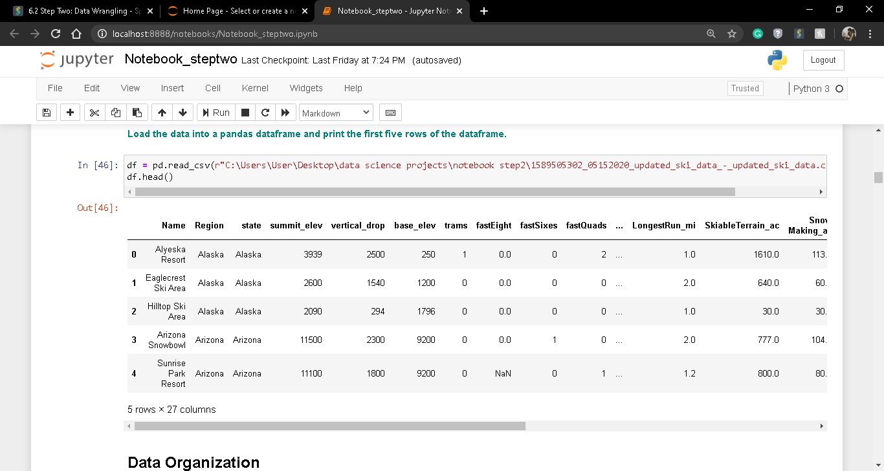
The primary dataset looks like this-

Slide 4
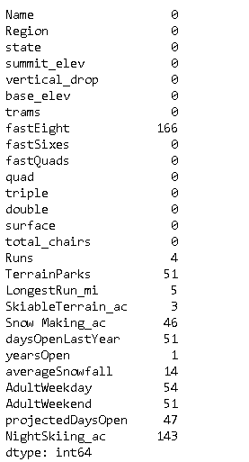
In the data set we can observe that few columns contains NaN datas in it.

Slide 5
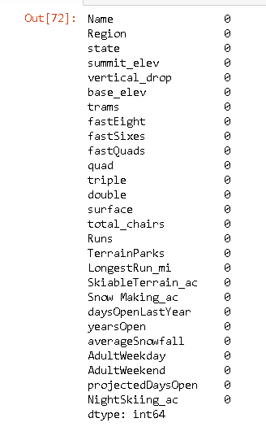
Handeling NULL Values
To handle the NaN values in the columns fastEight, Runs, TerrainParks, LongestRun_mi, SkiableTerrain_ac, Snow Making_ac , daysOpenLastYear , yearsOpen , averageSnowfall , AdultWeekday ,AdultWeekend ,projectedDaysOpen , NightSkiing_ac we replaced the NaN values with the Mean values of the column.

Slide 6
After removing NAN values

Slide 7
Exploratory Data Analysis
After plotting the state and region barplot we can observe that the data present in these two columns are quite same.

Slide 8
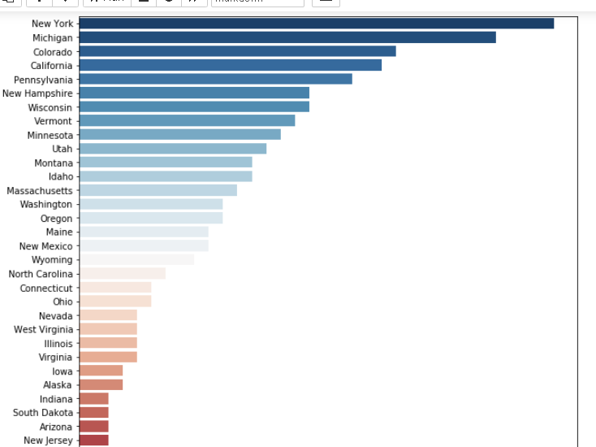
State and Region columns barplot

Slide 9
So to avoid duplicate columns we need to drop Region column.
After this we need to find out the outliers value present in the columns to get rid of the out liers. For this we plotted a boxplot.

Slide 10
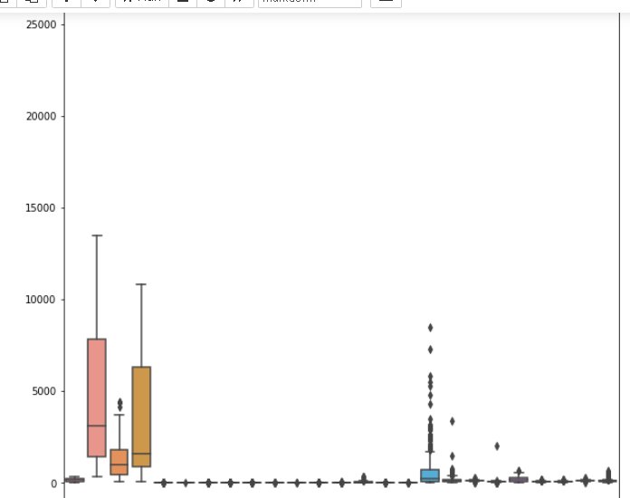
Plotting BoxPlot
From the boxplot we can see there are outliers present in a high range for some of the columns. To get rid of this we will calculate the inter quartile range if the column and drop all the rows which contain 1.5 times higher or lower value than that. so after doing this the boxplot looks like this

Slide 11
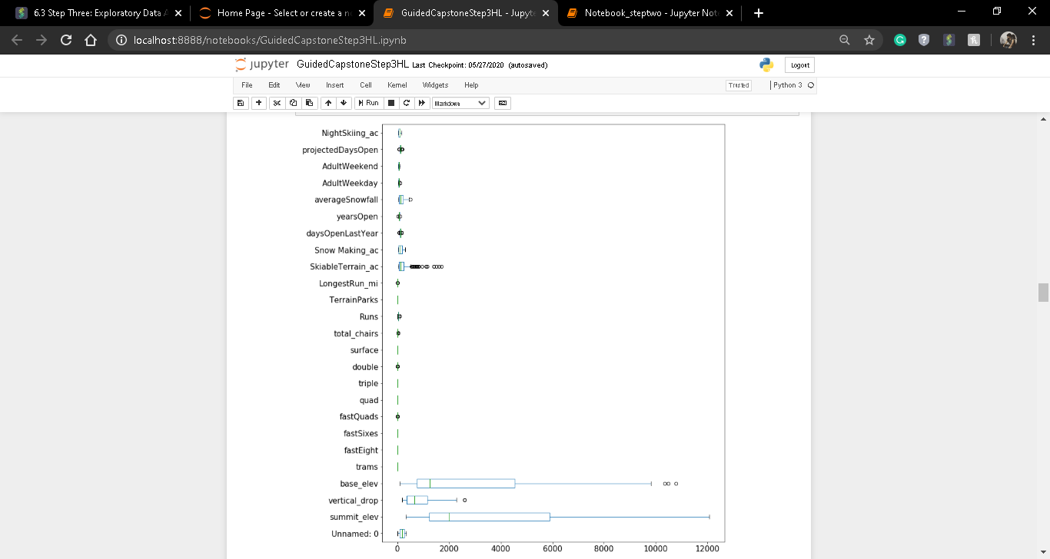
After removing outliers

Slide 12
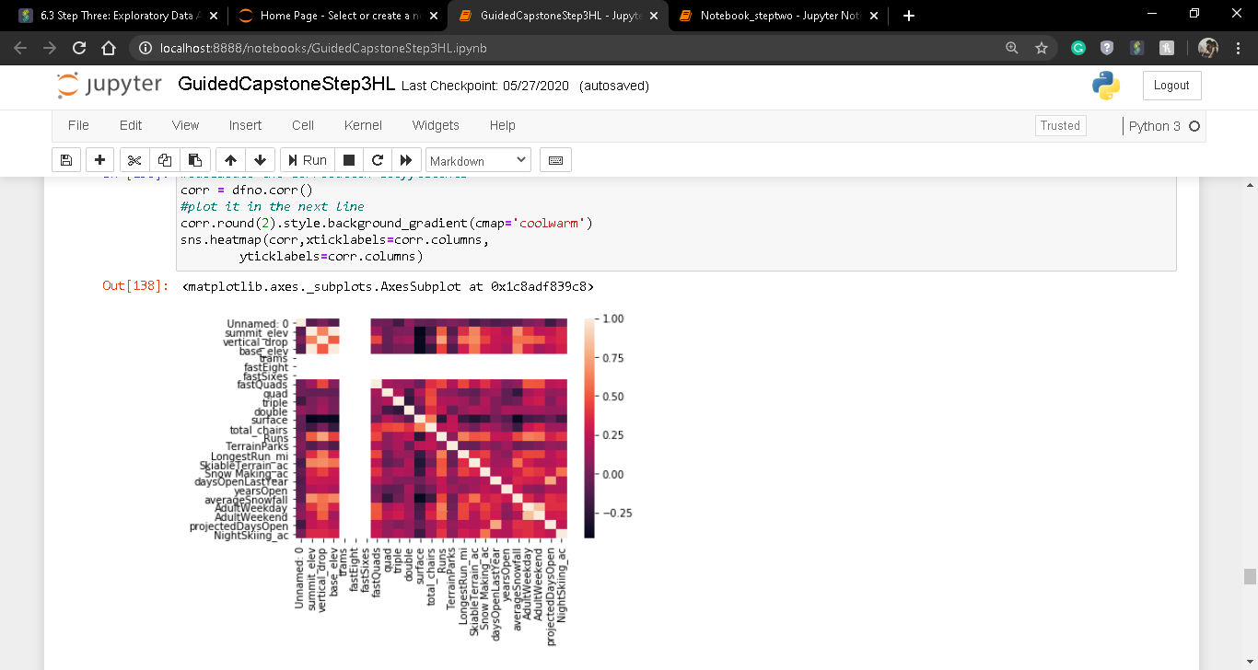
Identification and creation of features plotting correlation heatmap
From this we can find out the column which has correlation over 0.95 and after dropping that if we plot the cluster distribution of the dataset the it looks like this,

Slide 13
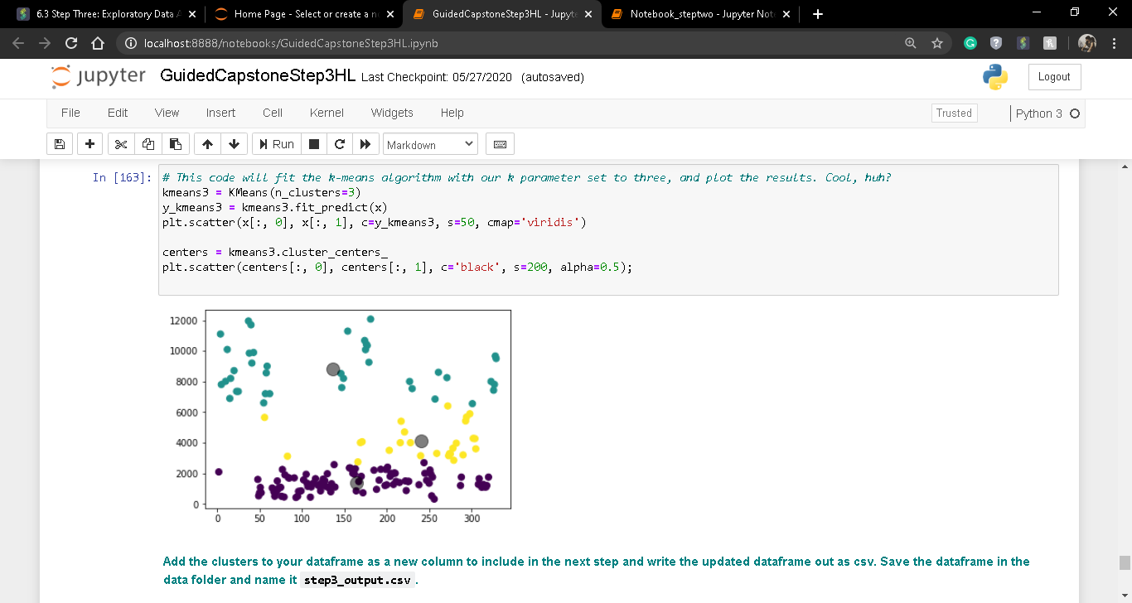
Cluster forming
Here we can see the categories forming clusters based on their category. The grey circles are the centroids of each clusters.

Slide 14
Pre-processing and Training Data Development
To handle categorical values of the dataset we need to see the dummy variables of them. And append them with the original dataset and drop the original column. After this we need to split the data set into training and test set. Train column should contain everything except the name and AdultWeekend column and test should contain AdultWeekend.

Slide 15
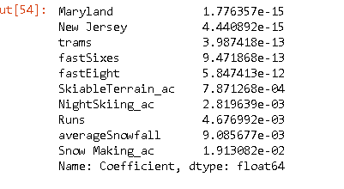
Modeling
Here we can see the categories forming clusters based on their category. The grey circles are the centroids of each clusters.

Slide 16
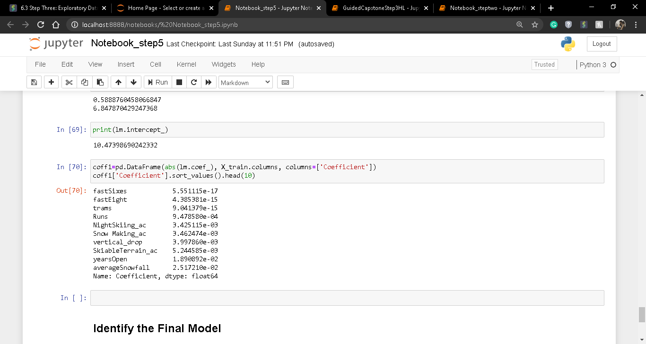
So in the next step we remove all the states and then again calculate fit the model and predict. Now we can observe that base_elev and summit_elev are highly correlated. So in the new model we remove these column and predict the output.

Slide 17
Model Selection
From this we can come on to a decision that the 3rd model is the best model for us.

Slide 18
Observation & Findings
Initially with the dataset we noticed the Big Mountain Resort data falls in a outlier portion.
So, after training our model out model predicted the Adult Weekend price for Big Mountain Resort should be near
73.08 dollars where currently it was charging 81 dollars.

Slide 19
Conclusion
So from here we can predict that if installation of the additional chairlift the adult weekend price will go down which help increase the distribution of visitors across the mountain more people should come to visit the place.

Slide 20
Thank You

